Slide 1

Wine Quality Machine Learning
Christine Olmeda
UM Data Analytics Boot Camp
Final Project

Slide 2
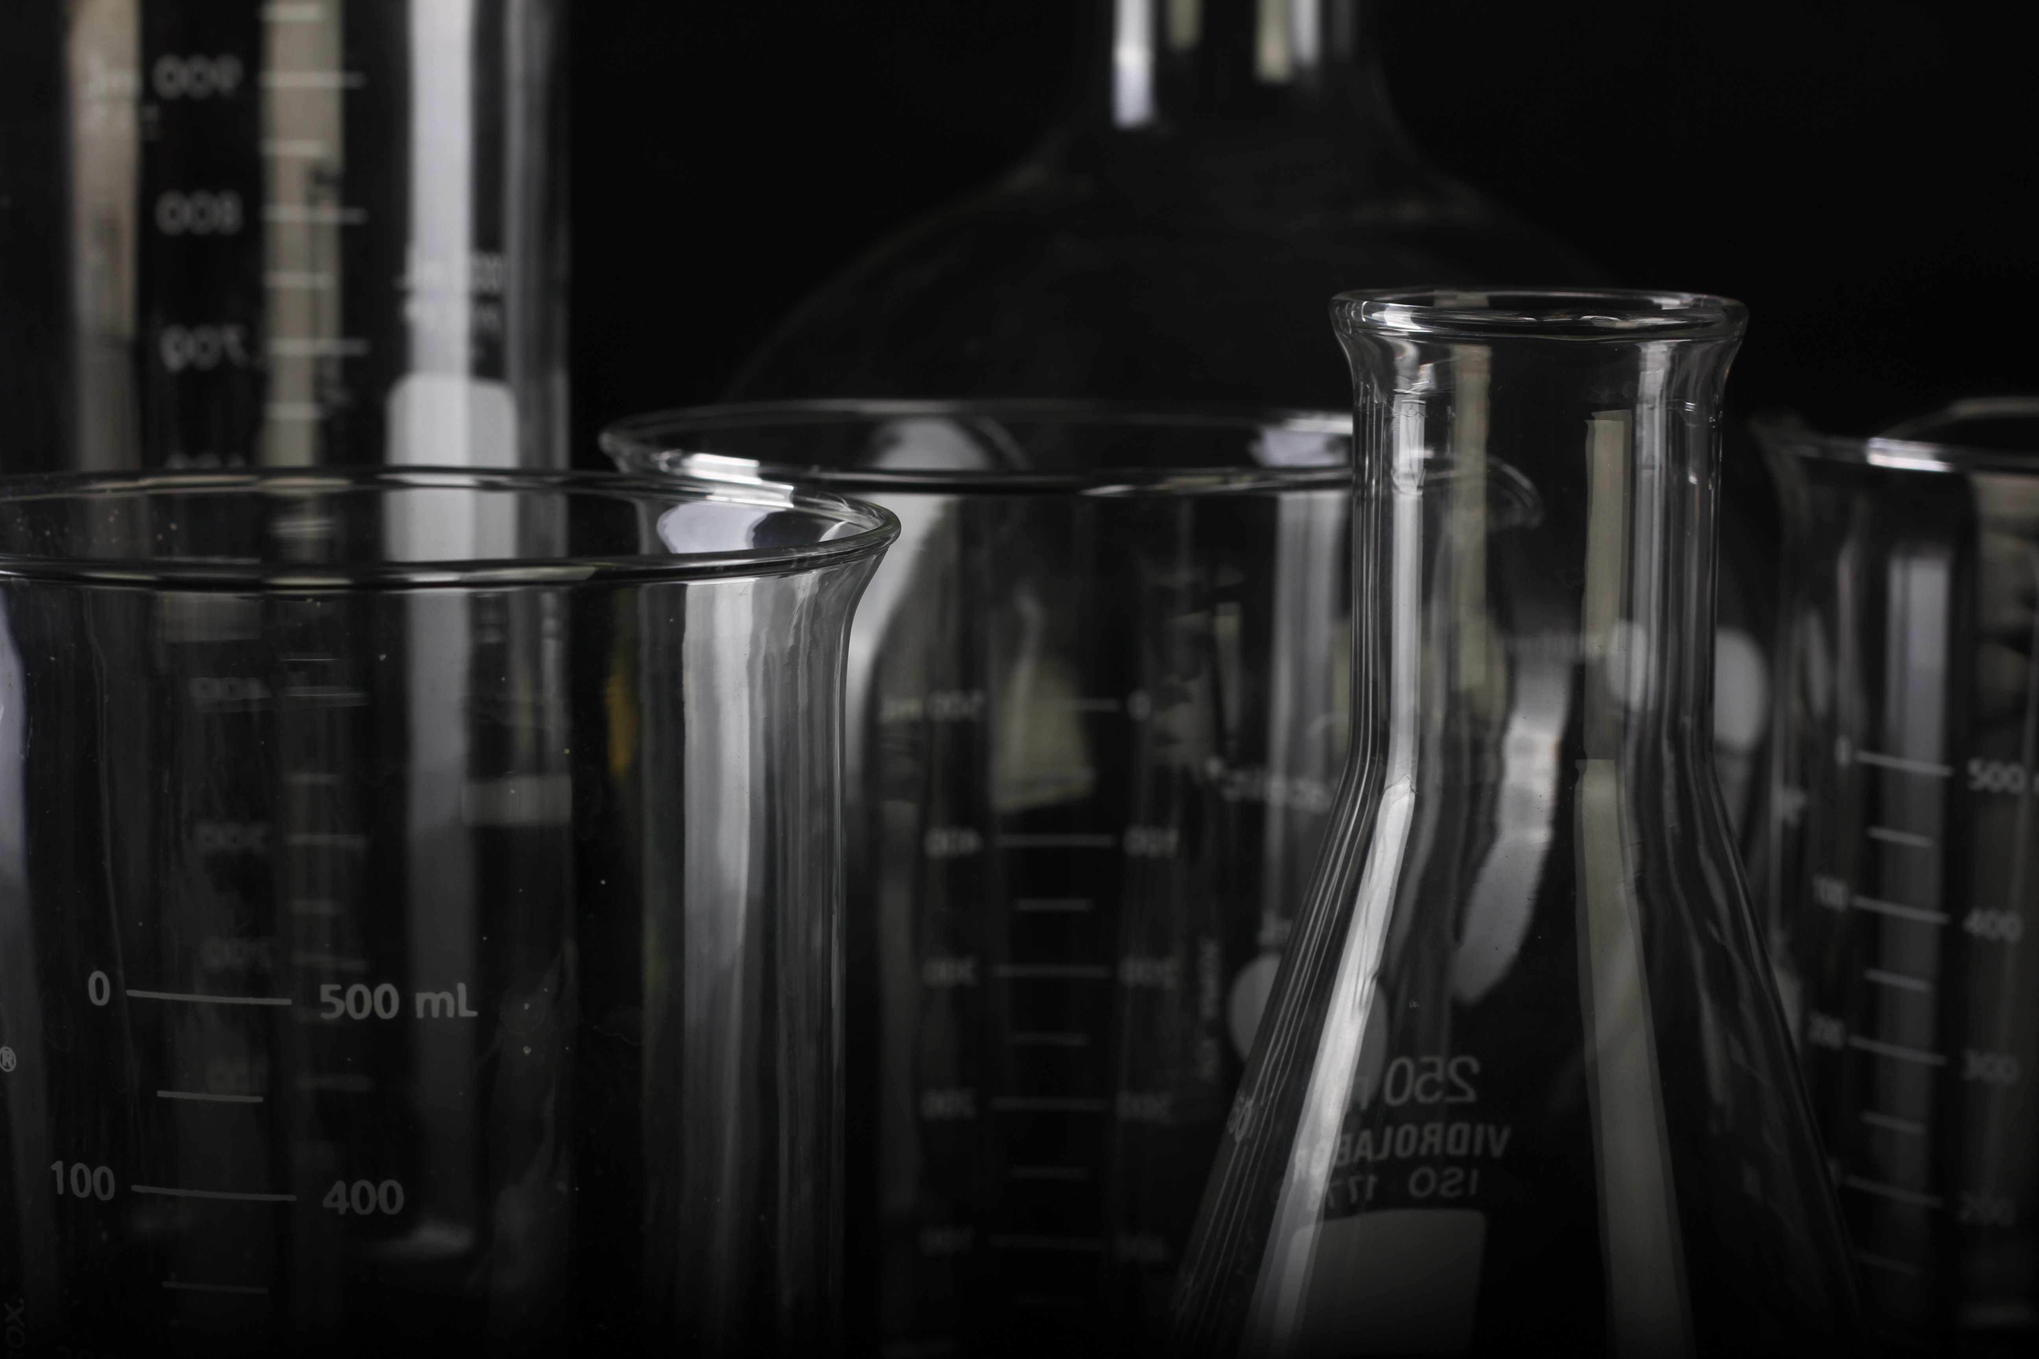
Wine Data Set Includes:
Fixed acidity
Volatile acidity
Citric acid
Residual sugar
Chlorides
Free sulfur dioxide
Total sulfur dioxide
Density
pH
Sulphates
Alcohol
Quality

Slide 3

Methods
Python
Pandas
Matplotlib
Seaborn
Scikit-Learn
KMeans
NbViewer

Slide 4
Deployed at NbViewer
Data Exploration:
https://nbviewer.jupyter.org/github/christine-c-o/Final_Project_Olmeda/blob/main/JupyterNotebooks/Final_Project_Olmeda_JupyterNotebook_DataExploration.ipynb
Machine Learning:
https://nbviewer.jupyter.org/github/christine-c-o/Final_Project_Olmeda/blob/main/JupyterNotebooks/Final_Project_Olmeda_JupyterNotebook_Machine_Learning.ipynb

Slide 5

Conclusion: Wine quality is a personal preference. Drink what you enjoy, not what is rated highly!

